Slide 1

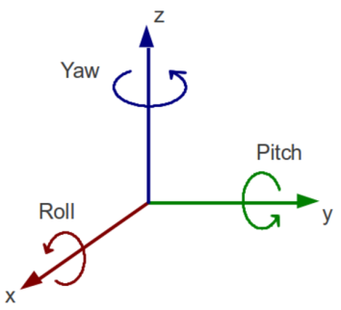
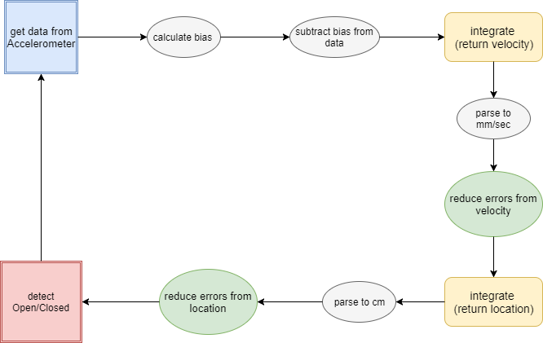
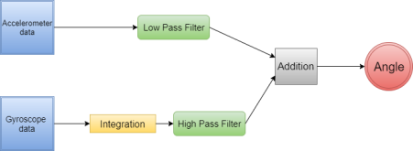
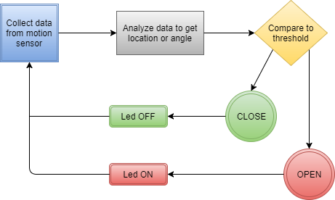
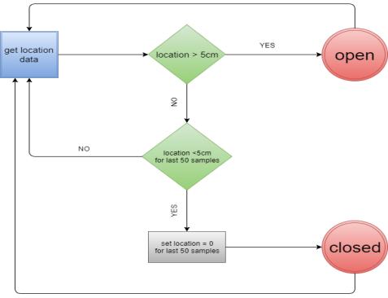
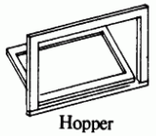
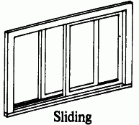
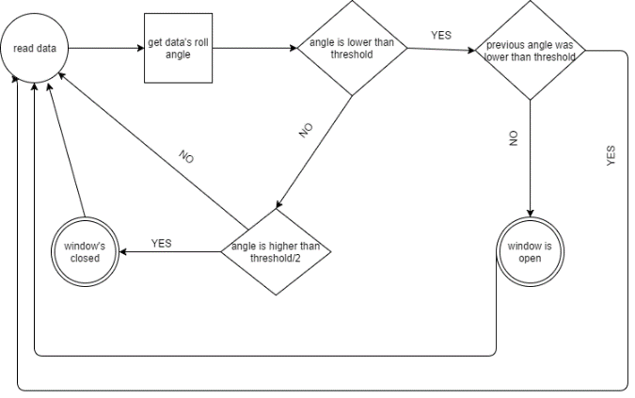
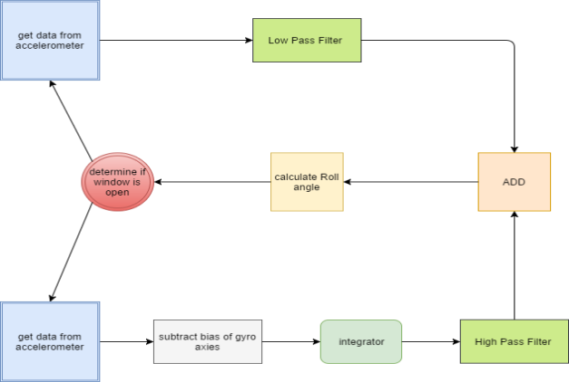
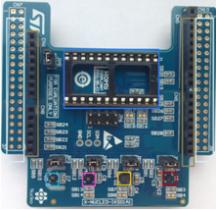

MEMS Battery operated project
Project Number: 16-1-1-1127
By: Mari Mishel, Daniel Akua Advisor: Arkadi Rafalovich
Project Carried Out at Tel Aviv University
Entrance opening detection using motion sensor
Micro controller receives constant sampling of accelerometer and gyroscope and outputs whether a window or door is open or closed.
The algorithm and data usage varies according to the entrance’s opening mechanism.
General algorithm diagram for all openings:
Sliding window:
This window’s opening can be detected by calculating the change in location.
Detection of opening:
Opening threshold = 5cm
Detection of closing:
Check 50 samples, if all samples under 5cm – window closed.
Algorithm diagram:
Complementary filter:
In order to surpass the gyroscope’s drift and the accelerometer’s vibrations errors, we will use complementary filter. This filter combines LPF, HPF and an integrator:
LPF filters high frequency signals from accelerometer’s vibrations.
HPF filters the low frequency signals from gyroscope’s drift.
Integrator creates angles from angular velocity (gyroscope’s samples).
This filter produces a signal that is not suffering from
Calculating pitch and roll:
With a 3-axis accelerometer, we can use the Z-axis to combine with the X and Y axes for tilt sensing in order to improve tilt sensitivity and accuracy.
Equations for tilt calculation:
$$velocity=\int{(ac{celerometer}_{data}) dt}$$
$$location=\int{(velocity) dt}$$
the errors of the accelerometer and the gyroscope.
Hopper window:
This window’s opening can be detected by calculating the change in the angle. The data sampled from the accelerometer and the gyroscope goes through complementary filter. The resulting angle is compared to the threshold to determine opening/closing event as follows:
Detection of opening:
Detection of closing:
Where Threshold = 20 degrees
Algorithm diagram:
Motion sensor:
Motion sensor samples accelerometer in mg/sec and gyroscope in mrad/sec at:
f = 200 Hz.
Meaning 200 samples per second. This data is fed to the algorithm for further processing.

